Slide 1
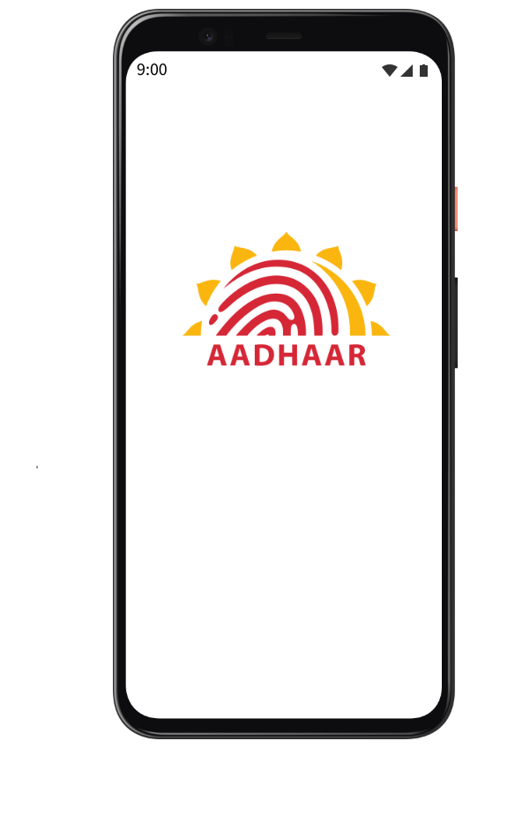
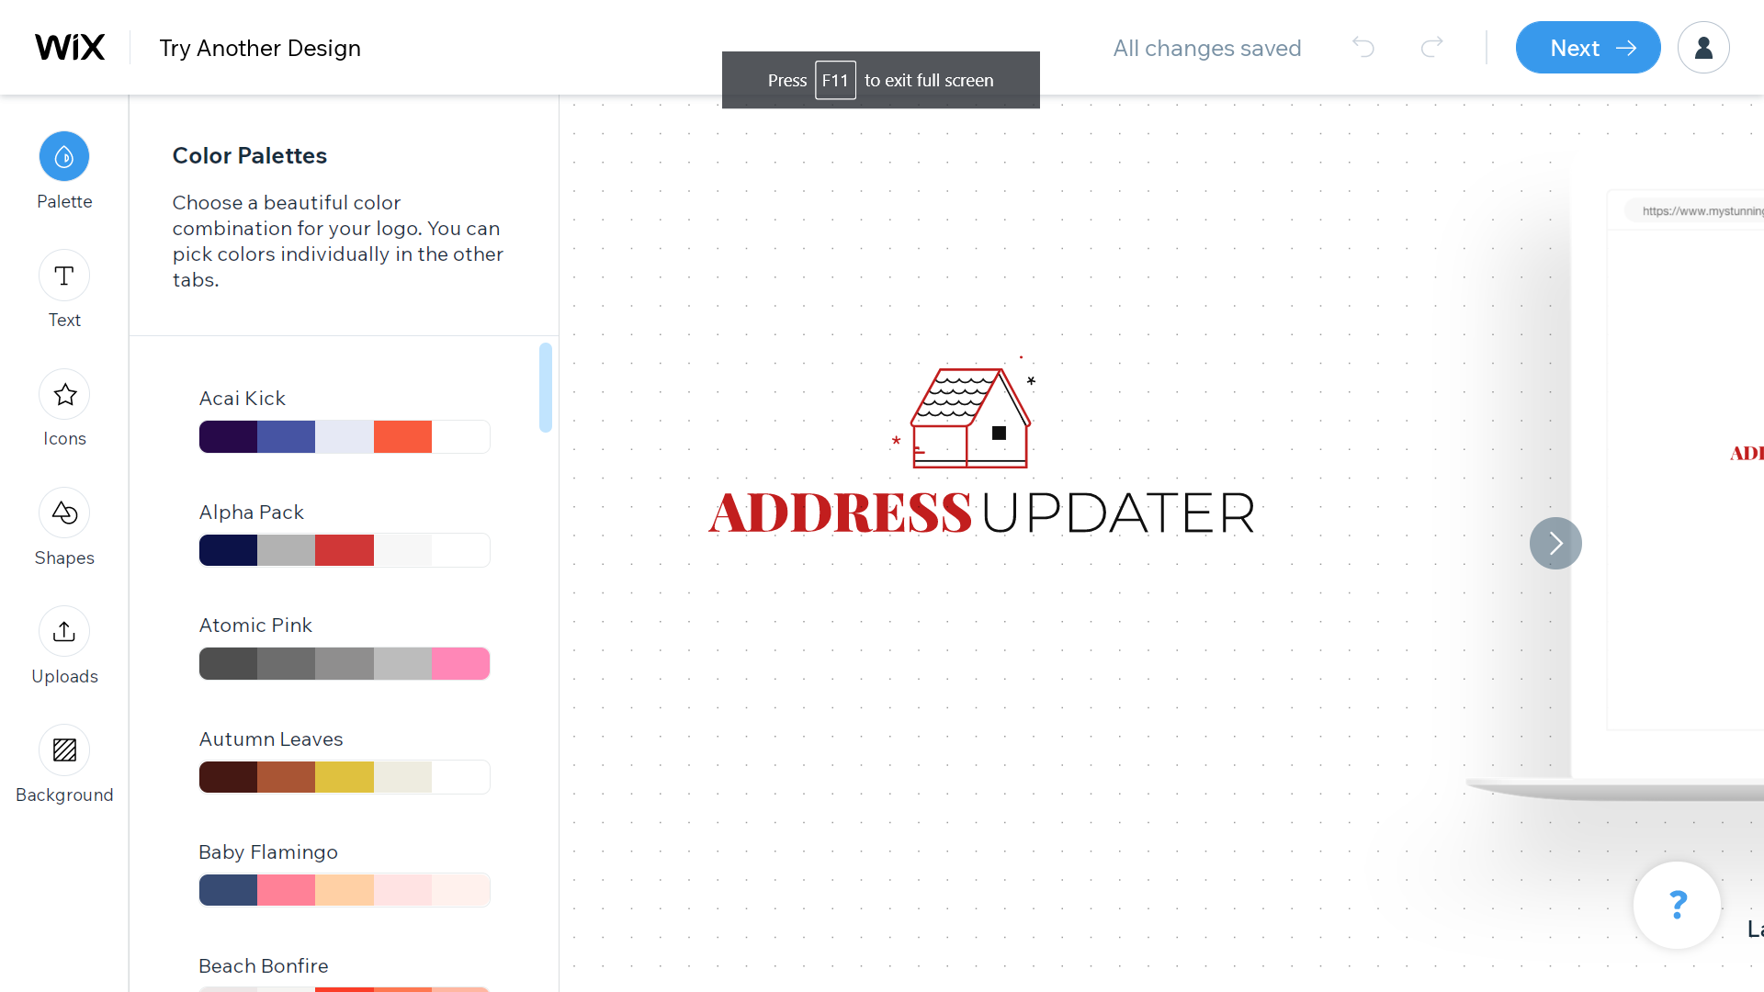
UIDAI
Hackathon Submission
Team Name : The_Hashers
Participants : Jayant Taneja
Ridham Bhat
Sayantanu Dey
Hridyansh Pareek
Varitant Arora

Slide 2
Outline
Theme Chosen
Problem Statement
Solution Proposal
App Screenshots

Slide 3
Theme Chosen:
Theme 1 : Address Update

Slide 4
Problem statement
In the last 10 years, Aadhaar has enabled 130+ cr residents of India, with digital identity. It has supported inclusiveness by enabling residents to interface with various Digital India initiatives.
To facilitate enrolment to the Aadhaar platform and for the subsequent update of Aadhaar during life events, UIDAI has established a large number of enrolment centers across the country. Also, it has established a self-service online platform to interface and undertake update of demographics data. Even with the abundance of touch points, UIDAI believes that there is a scope to improve the experience around the online address update process through the adaptation of technology
The Aadhaar team is calling for innovative ideas and solutions, backed up by demonstrable code from young minds to enhance the address update experience of a resident. Show your problem-solving skills and understanding on open-source technologies to build an online address update process covering the use cases listed in the document.

Slide 5
What people do today
Manual Address Update
The most common method that people use today is to go to their nearest Aadhaar center and manually get their documents verified for address update
This not only requires a lot of time, but is also restricted to office hours. Our app aims to change this

Slide 6
Solution Proposal:
AADHAAR Address Update APP

Slide 7
Solution description
We have built a Flutter powered cross platform app that aims to solve the problem of updating address in AADHAAR card. Here’s how it works:
User opens the app and enters the AADHAAR number
The OTP API verifies the AADHAAR number and sends an OTP to the user
Upon entering valid OTP, the user is directed to the home screen
Here the user has the option to view previous update history or follow the steps to update address using OCR.

Slide 8
Information architecture
Splash Screen
Aadhar OTP Login
Address Update Screen
Check and Verify that scanned address and device location match
Fetch device location using Geocode API
Scan documents and extract address using OCR.
Allow minor edits
Update Address

Slide 9
Our Goal
In today’s world, with the increasing number of apps and services, unfortunately the complexity of the apps have also increased. Hence, we aim to provide an app with the following features:
Simple and clean UI
Smooth Animations
Clutter free design

Slide 10
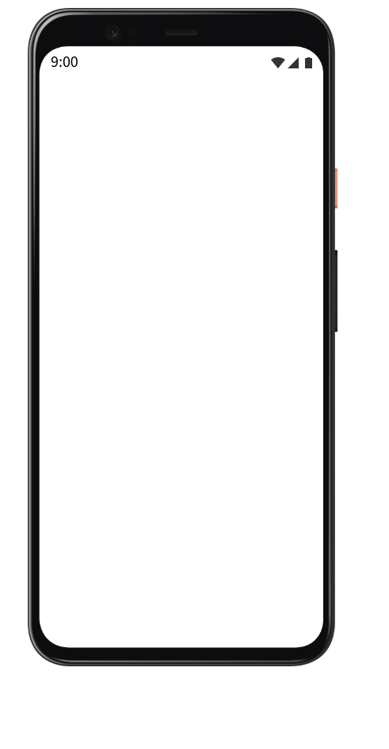
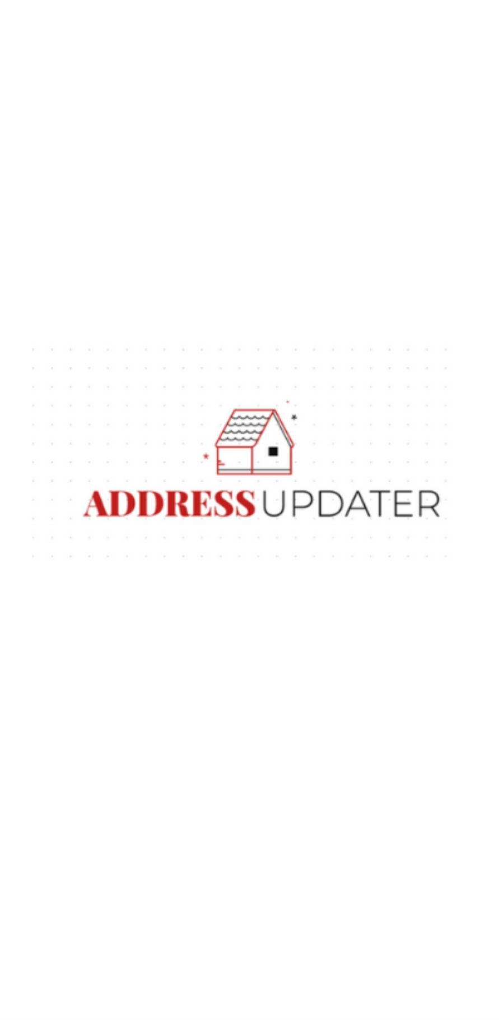
Splash Screen
Splash screen greets the user on app start

Slide 11
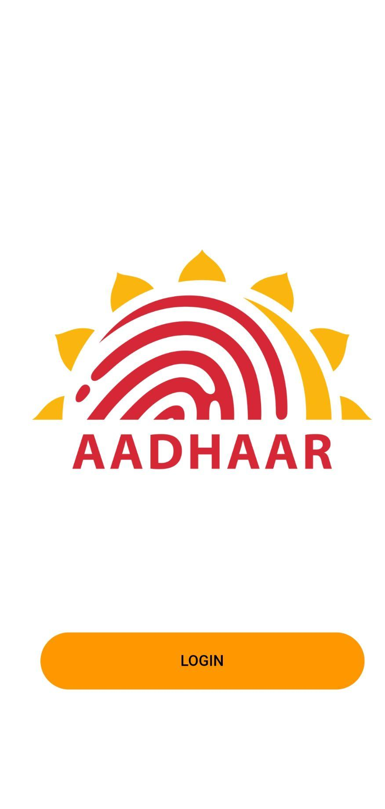
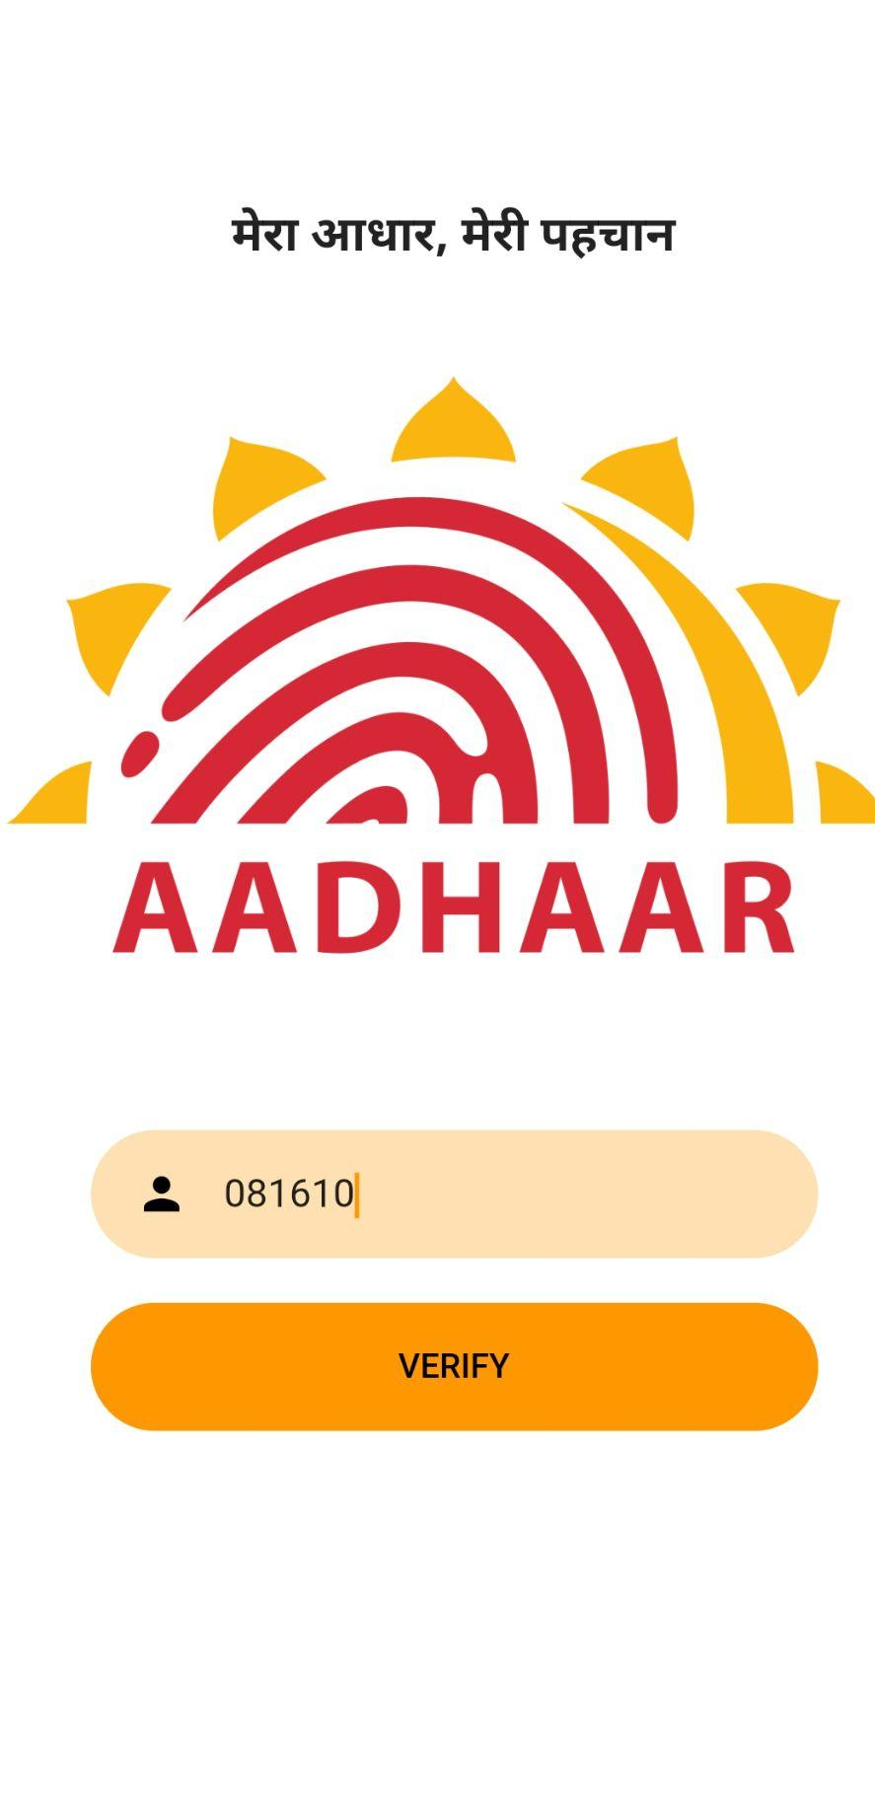
Login Screen
Enter Aadhar number to get OTP and login to app

Slide 12
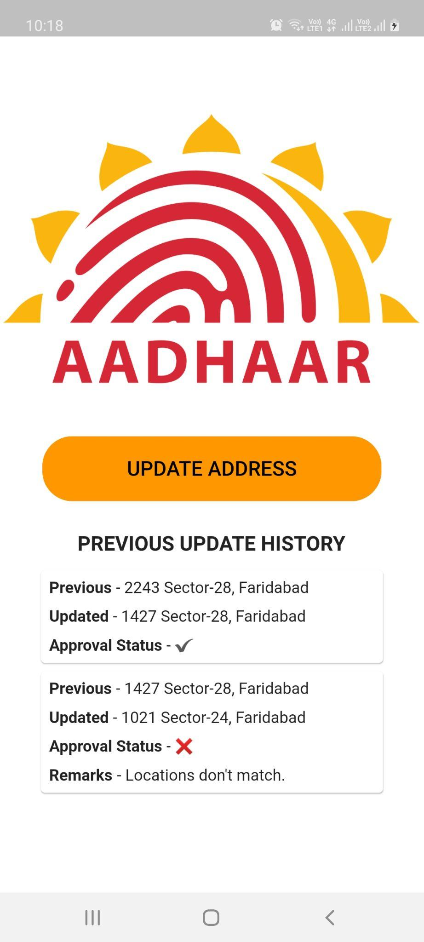
Home

Slide 13
Thank you!

